Slide 1

Hybrid TimeMixer-XGBoost PM2.5 Forecasting App
DAP391m Project
Artificial Intelligence & Data Science Project
FPT University | Ho Chi Minh City
Students: Dong Bao Han - Tran Loi Kieu Nhi - Pham Hoang Tu Ngan
Supervisor/Mentor: Le Vo Minh Thu

Slide 2
Outline - Presentation Structure
PART 1 - Problem & Data Understanding
Slide 3: Problem Understanding
Slide 4: Research Questions
Slide 5: Data Understanding
Slide 6-8: EDA and SQL-linked analysis
PART 2 - Feature Engineering & Visualization
Slide 9: Feature Engineering
Slide 10: Advanced Data Visualization
Slide 11: Interactive Dashboard
PART 3 - Modelling, Evaluation & Pipeline
Slide 12: Dataset Partition
Slide 13: Data Modelling
Slide 14: Model Evaluation
Slide 15: Hyper-parameter Tuning
Slide 16: Final Pipeline
PART 4 - AI Application & Reflection
Slide 17-18: Prototype and AI-powered solution
Slide 19-20: Conclusion, Reflection, and Q&A

Slide 3
Step 1 - Problem Understanding
Problem: hourly PM2.5 concentration is noisy, station-dependent, and difficult to forecast across multiple future horizons.
Project goal: build and evaluate a PM2.5 forecasting system for 1, 6, 12, 24, and 48 hours ahead.
Why it matters: forecasting PM2.5 supports air-quality analysis and early interpretation of pollution changes.
Main AI question: can a gated TimeMixer-XGBoost residual layer safely improve TimeMixer forecasts across several stationsNote:

Slide 4
Research Questions (RQ1, RQ2, RQ3)
[RQ1] Which model forecasts hourly PM2.5 most accurately across horizons and stationsNote:
Target: PM2.5 concentration. Task type: time-series regression.
[RQ2] Does the gated TimeMixer-XGBoost residual layer improve the TimeMixer base modelNote:
Comparison: TimeMixer vs static hybrid vs gated hybrid.
[RQ3] Are conclusions stable when all stations use the same 2021-2025 historyNote:
Purpose: address reviewer concern about unequal historical coverage.

Slide 5
Step 2 - Data Understanding
Dataset: UK-Air hourly PM2.5 time-series records from five monitoring stations.
Key question (EN) | Hướng dẫn thực hiện (VN)
Feature Note: | Xác định các biến đầu vào (features): loại dữ liệu số, categorical, text, thời gian
Target Note: | Xác định biến mục tiêu (target/label): là gìPhân phối ra saoCó mất cân bằng khôngNote:
Classification or RegressionNote: | Classification: target rời rạc (0/1, nhãn). Regression: target liên tục (giá, doanh thu)
Business context | Hiểu domain: logistic, fintech, fashion... Tại sao bài toán này quan trọngNote:
Define success metrics | Định nghĩa thành công: Accuracy/F1 (classification) hay RMSE/R2 (regression)Note:
RBL: Justify + AI Audit Log | Trích dẫn paper để justify bài toán. Log prompt brainstorm problem statement

Slide 6
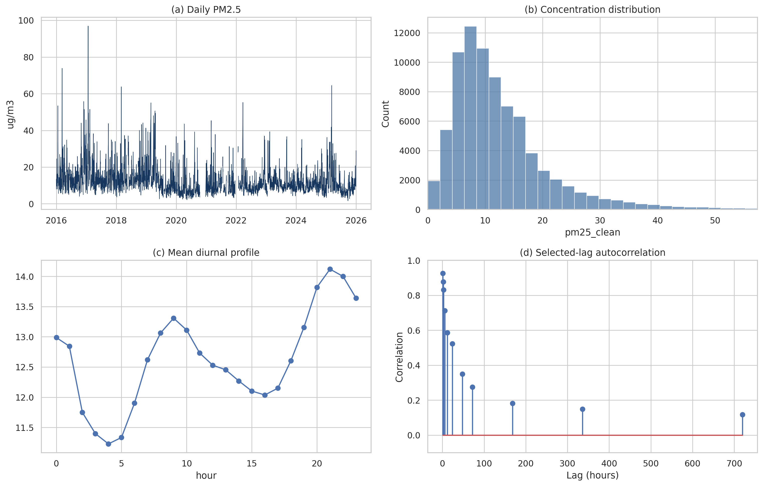
Step 3 - EDA (Univariate)
Key EDA findings
• PM2.5 is right-skewed with rare high-pollution episodes.
• Daily PM2.5 shows short-term spikes and long-term variation.
• Mean PM2.5 changes by hour, showing a daily pattern.
• Autocorrelation confirms past PM2.5 is useful for forecasting.
Univariate checks focus on one variable at a time: PM2.5 value, timestamp, missingness, and coverage.

Slide 7
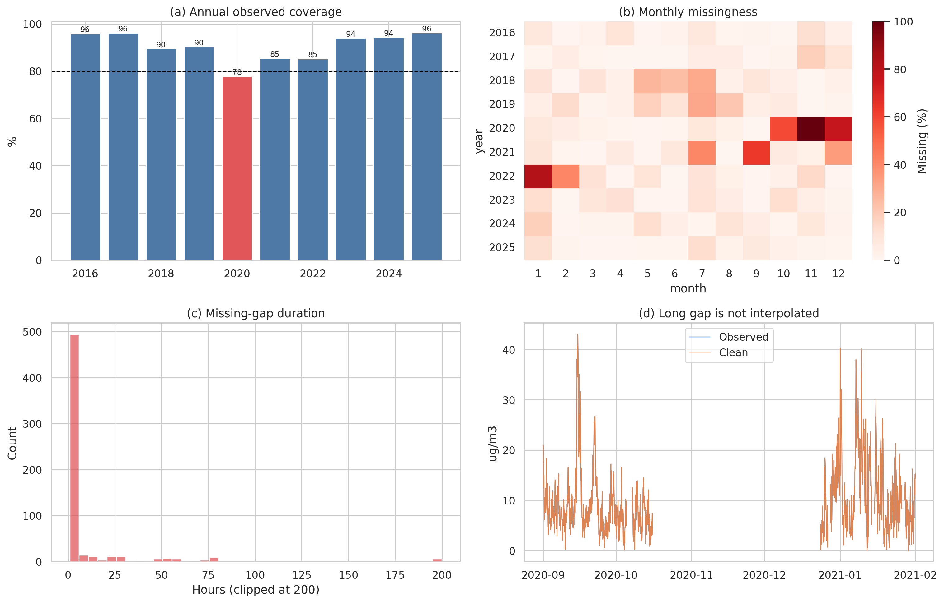
Step 3 - EDA (Bivariate & Multivariate)
Bivariate analysis links PM2.5 to time features such as hour, day, month, station, and horizon.
Key EDA findings
• Coverage varies by year; 2020 has the lowest coverage.
• Most missing gaps are very short.
• A few long gaps still appear in the data.
• Long gaps should not be linearly interpolated.
• Missing/gap indicators are useful features.

Slide 8
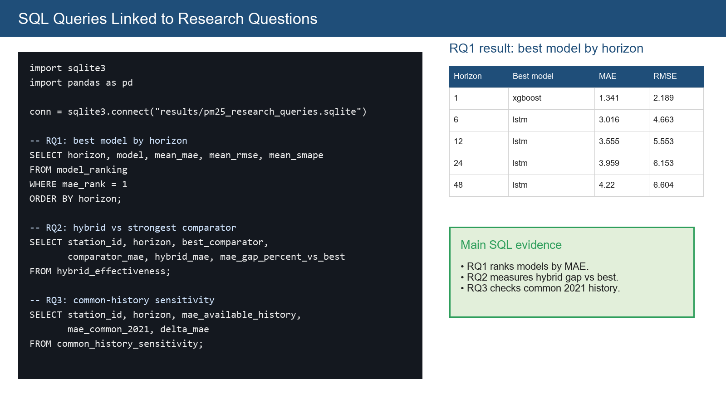
SQL Queries Linked to Research Questions

Slide 9
Step 4 - Feature Engineering
Feature rule: every predictor must be known at forecast origin to avoid data leakage.
Technique (EN) | Hướng dẫn chi tiết (VN)
Skewness / Missing / Outlier Handling | Log transform (skew), fillna/dropna (missing), cap/remove (outlier) — ghi lý do từng bước
Feature Enrichment | Tạo biến mới từ business domain: ratio, difference, aggregation theo nhóm, time lag
Feature Transformation | Polynomial features, binning (pd.cut), log/sqrt transform cho phân phối lệch
Feature Selection | Correlation filter (|r|>0.9 drop), VIF (multicollinearity), SelectKBest, RFE
Feature Encoding | LabelEncoder (ordinal), OneHotEncoder (nominal), TargetEncoder (high cardinality)
Feature Scaling | Normalization: MinMaxScaler [0,1]. Standardization: StandardScaler (z-score). Khi nào dùngNote:

Slide 10
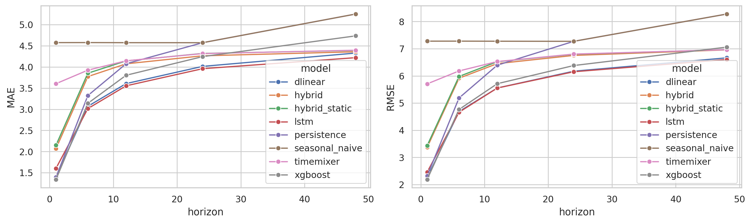
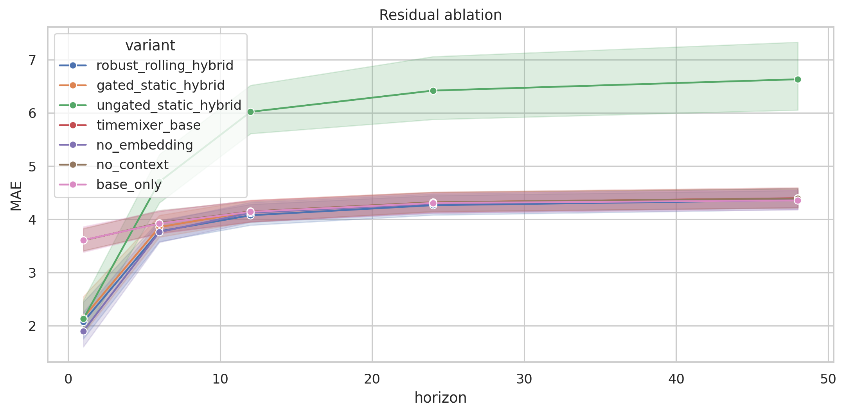
Advanced Data Visualization
Main figures generated by code:
Data overview and quality figures.
Multi-station model-effectiveness figure.
Model-metric comparison by horizon.
Residual ablation and seed-variability plots.
Bootstrap uncertainty and sensitivity evidence.
Insight
Model metrics show LSTM/DLinear as strongest pooled baselines; residual ablation shows gating reduces over-correction.

Slide 11
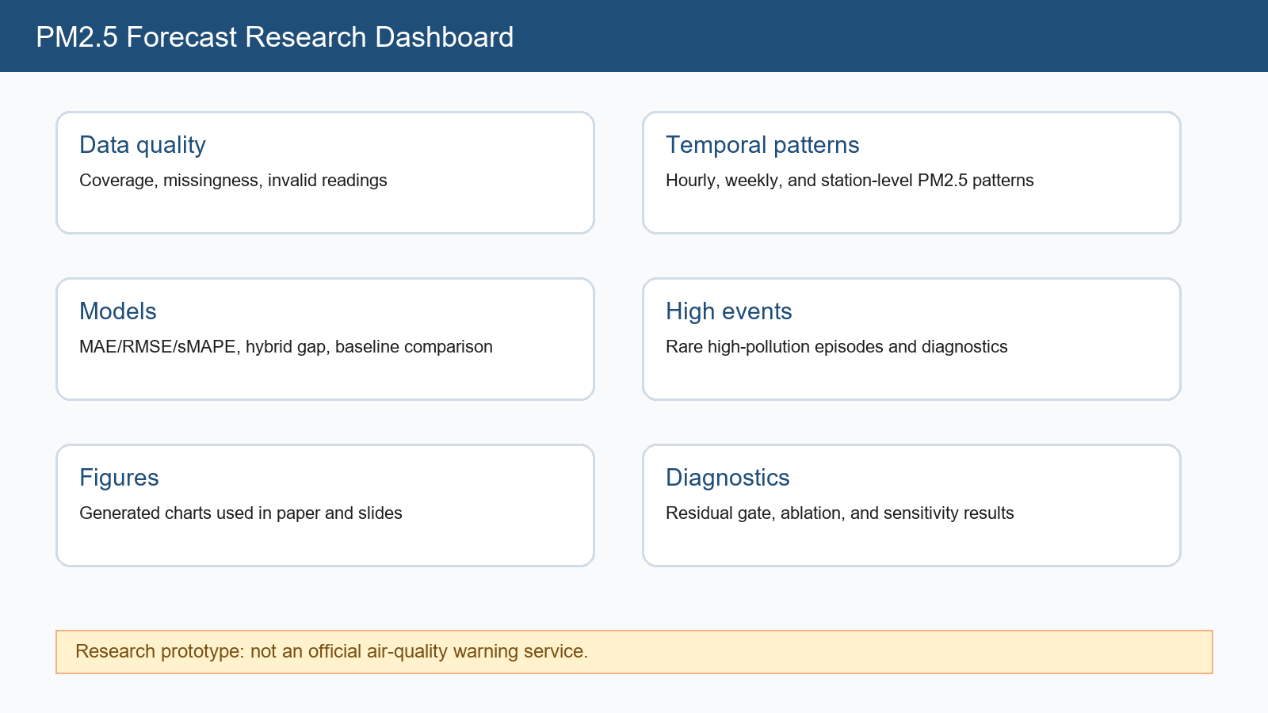
Interactive Dashboard (Research App)
The project includes a Streamlit dashboard organized like the sample app structure.

Slide 12
Step 5 - Dataset Partition
Chronological partitioning prevents future leakage.
Training period: model fitting before the validation/calibration/test eras.
Validation period: early stopping and neural model selection.
Calibration period: residual gate and alpha selection.
Locked test period: final evaluation from 2024 onward.
Sensitivity design: common 2021-2025 history is used for all stations to test whether unequal station history changes the conclusion.

Slide 13
Step 6 - Data Modelling
Models compared: persistence, seasonal-naive, XGBoost, LSTM, DLinear, TimeMixer, static hybrid, and gated hybrid.
Proposed model: TimeMixer generates base forecasts; XGBoost learns residual errors; the gate controls whether residual correction is used.
This satisfies the requirement to compare at least five modelling approaches.
Residual safeguards: median de-biasing, pseudo-Huber robust loss, bounded correction, calibration-selected alpha, and rolling bias calibration.

Slide 14
Step 7 - Model Evaluation (Table)
Evaluation metrics: MAE, RMSE, sMAPE, RNote:, and paired comparison summaries.
Metric (EN) | Ý nghĩa & Khi nào dùng (VN)
Accuracy | Tỷ lệ đúng tổng thể. Dùng khi các class cân bằng. Không dùng khi imbalanced
Precision / Recall / F1-score | Precision: đúng trong positive dự đoán. Recall: bắt được positive thực. F1: harmonic mean
AUC-ROC | Diện tích dưới ROC curve. AUC=1 hoàn hảo, AUC=0.5 random. Tốt cho imbalanced
R2 Score | Regression: tỷ lệ variance giải thích được. R2=1 hoàn hảo, R2<0 tệ hơn mean
MSE / RMSE / MAE | MSE: mean squared error. RMSE: căn bậc 2 MSE (đơn vị gốc). MAE: ít nhạy outlier hơn
Compare with baseline paper | So sánh metrics của nhóm với kết quả trong paper của dự án. Giải thích sự khác biệt

Slide 15
Step 8 - Hyper-parameter Tuning
Training protocol: five seeds (0-4), maximum 30 epochs, AdamW, early stopping, and fixed chronological splits.
Tree/residual settings are centralized and reused across stations and horizons.
Result: the gate chooses zero correction in 56.8% of fits, reducing harmful residual over-correction.
Gate tuning: alpha is selected on calibration-validation only, not on test data.

Slide 16
Step 9 - Final Pipeline
Pipeline flow:
1. Load station CSV files.
2. Audit and clean PM2.5 records.
3. Build origin-safe features and windows.
4. Train baselines and hybrid models.
5. Evaluate locked-test and common-history sensitivity.
6. Export results, figures, paper, and dashboard artifacts.
What to build (EN) | Hướng dẫn chi tiết (VN)
AI service integration | AWS Lex+Transcribe / Watson IBM / GCP — chatbot hoặc voice Q&A về kết quả dự án
Application architecture | Sơ đồ: data → pipeline (Step 9) → dashboard + AI service + UI
Core features | Upload data, chạy pipeline, hiển thị prediction, đưa khuyến nghị từ model
Dashboard integration | Plotly/Dash tích hợp vào app — filter, KPI cards, chart liên kết RQ
Live demo required | Demo end-to-end trong buổi báo cáo — chuẩn bị screenshot dự phòng
RBL + AI Audit Log | Justify chọn service và công nghệ (RBL). Log prompt phát triển app; Human Delta

Slide 17
AI-Powered Application / Prototype
Prototype: PM2.5 research dashboard for exploring data quality, generated figures, model metrics, and residual diagnostics.
User value:
Quickly inspect station-level data issues.
Compare model performance by horizon.
Explain why the hybrid helps TimeMixer but not the strongest baseline.
Support presentation and review discussion.
The app uses generated research files instead of inventing demo metrics.

Slide 18
Develop Applications and AI-Powered Solutions
Possible extensions:
Add live API ingestion from official monitoring services.
Add meteorological covariates such as wind, humidity, temperature, and pressure.
Deploy dashboard to cloud hosting.
Add scheduled retraining and monitoring.
Add explainability for high-pollution events.
Responsible AI note: predictions should assist research interpretation, not replace official air-quality alerts.

Slide 19
Step 10 - Conclusion
RQ1 answer: LSTM is the strongest pooled model, while XGBoost is strongest at the shortest horizon.
RQ2 answer: gated hybrid improves TimeMixer, but does not beat the strongest baseline overall.

Slide 20
AI Reflection & Q&A
AI contribution: helped organize code, clean data, generate visualizations, prepare report text, and structure slides.
# | Evaluation Criteria | Max Points | Hướng dẫn AI Audit (VN)
1 | Final Report (LaTeX + Slides) | 20 pts | Log prompt viết báo cáo, format LaTeX Springer; reflection độ chính xác
2 | Business Understanding + Data Prep | 5 pts | Log prompt brainstorm, tìm data, câu hỏi nghiên cứu, data collection
3 | Data Analysis with Python | 10 pts | Log prompt code Python, feature engineering, justify lựa chọn
4 | Data Visualization in Advanced | 10 pts | Log prompt tạo chart, dashboard; evidence-based insights
5 | Build Model for Prediction | 15 pts | Log prompt huấn luyện, so sánh >= 5 mô hình với baseline paper
6 | Integrating AI Services | 10 pts | Log prompt tích hợp API/AI services; justify lựa chọn
7 | Develop AI-Powered Application | 10 pts | Log prompt phát triển app; Human Delta; architecture diagram
8 | Q&A + AI Reflection | 20 pts | AI Audit Log đầy đủ; Human Delta; Hallucination >=3; Checklist

